Slide 1
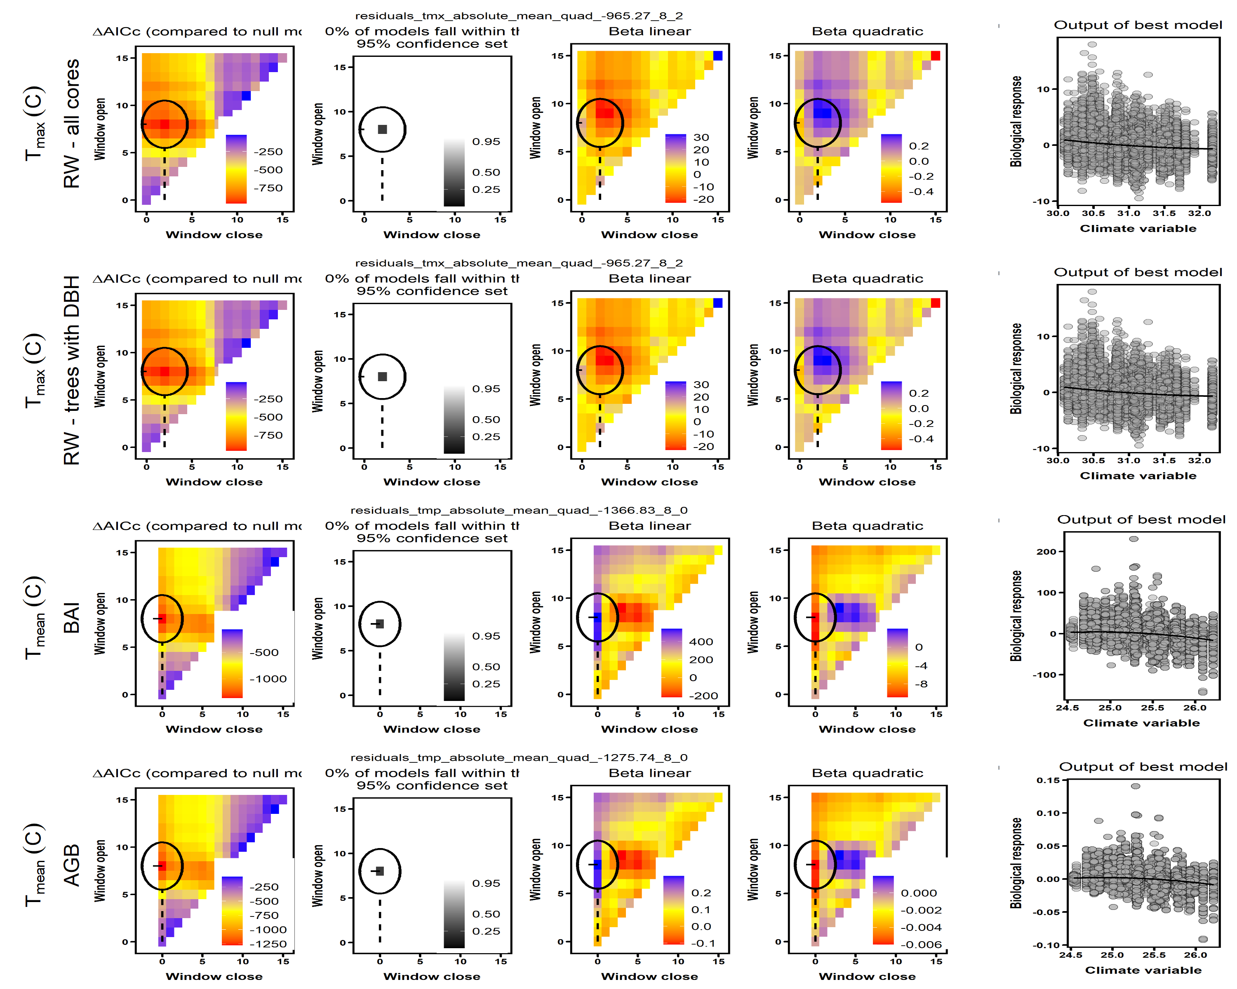
ΔAICc(compared to null model)
0% of models fall within the 95% confidence set
ΔAICc(compared to null model)
0% of models fall within the 95% confidence set
ΔAICc(compared to null model)
0% of models fall within the 95% confidence set
ΔAICc(compared to null model)
0% of models fall within the 95% confidence set

Slide 2
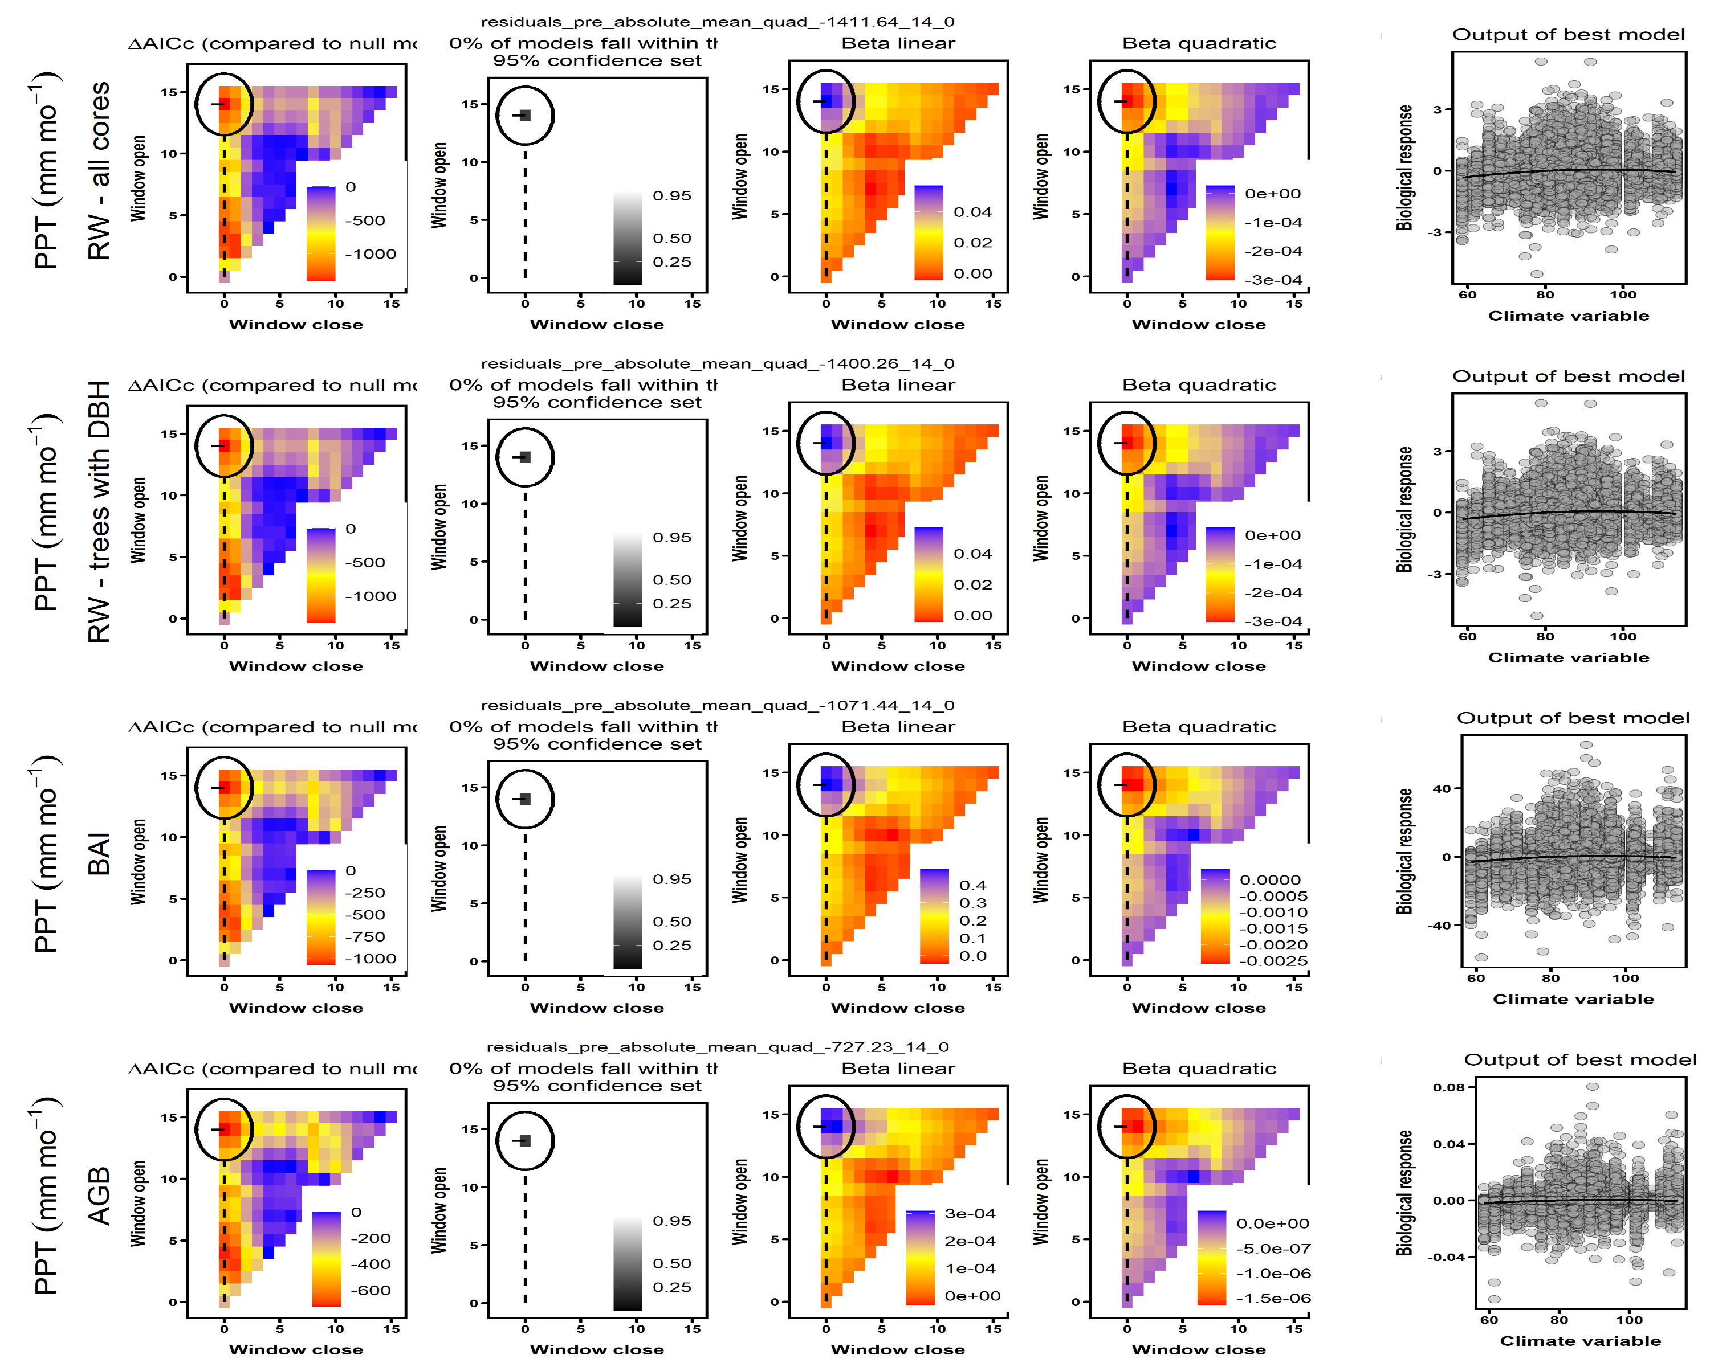
ΔAICc(compared to null model)
0% of models fall within the 95% confidence set
ΔAICc(compared to null model)
0% of models fall within the 95% confidence set
ΔAICc(compared to null model)
0% of models fall within the 95% confidence set
ΔAICc(compared to null model)
0% of models fall within the 95% confidence set

Slide 3
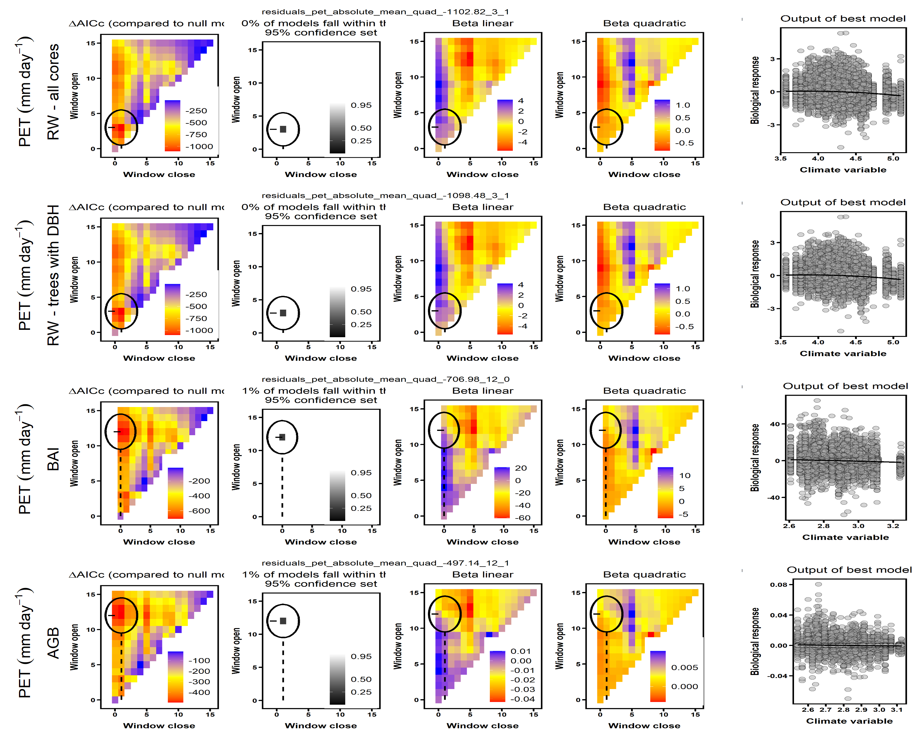
ΔAICc(compared to null model)
0% of models fall within the 95% confidence set
ΔAICc(compared to null model)
0% of models fall within the 95% confidence set
ΔAICc(compared to null model)
0% of models fall within the 95% confidence set
ΔAICc(compared to null model)
0% of models fall within the 95% confidence set

Slide 4
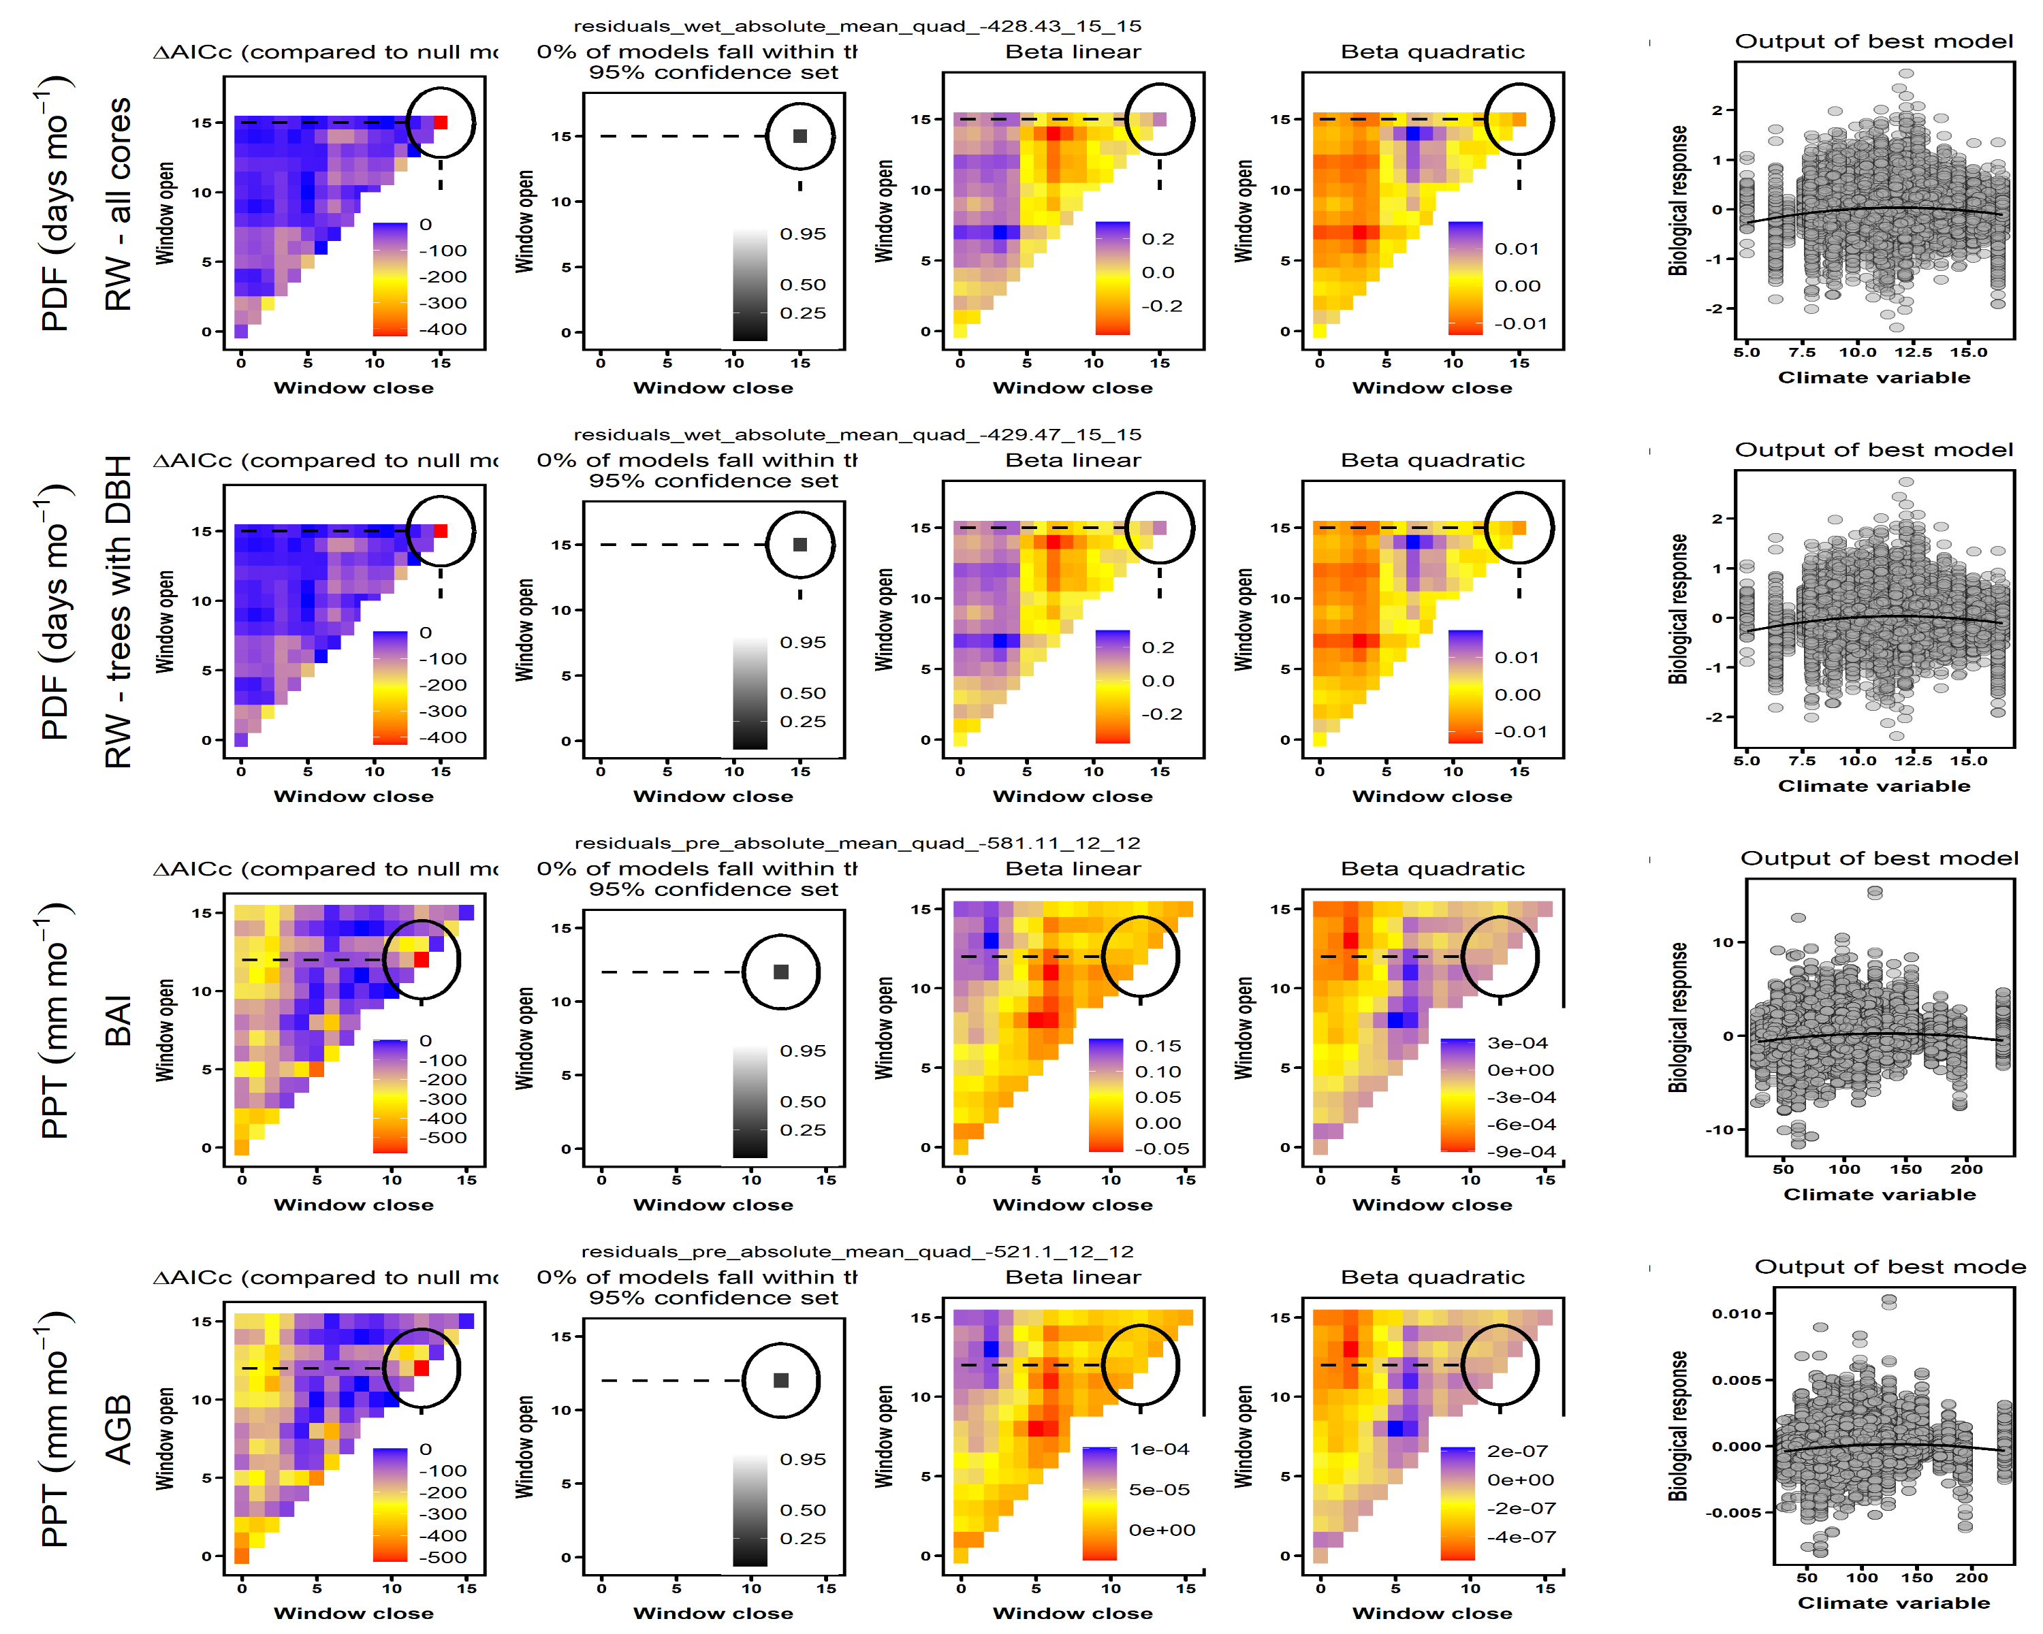
ΔAICc(compared to null model)
0% of models fall within the 95% confidence set
ΔAICc(compared to null model)
0% of models fall within the 95% confidence set
ΔAICc(compared to null model)
0% of models fall within the 95% confidence set
ΔAICc(compared to null model)
0% of models fall within the 95% confidence set

